Slide 1

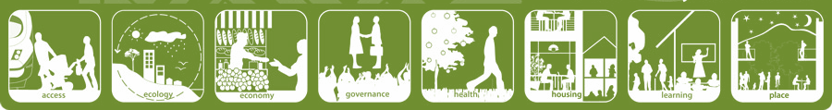
Lesson 5

Slide 2
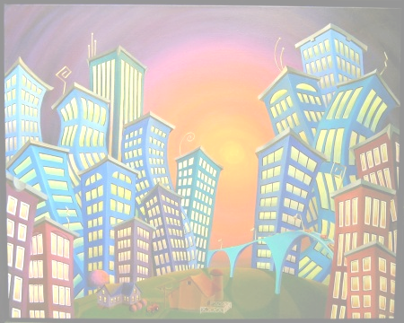
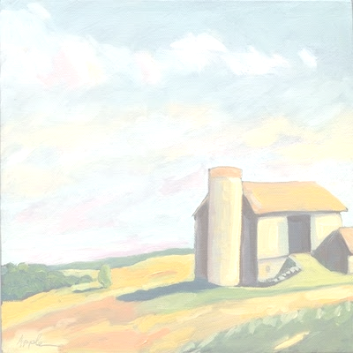
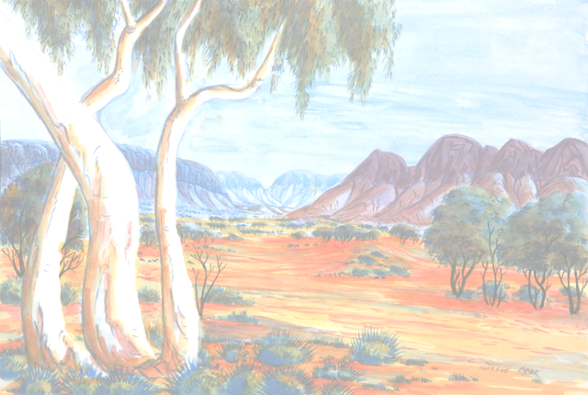

URBAN
RURAL &
REMOTE AREAS

Slide 3



Slide 4
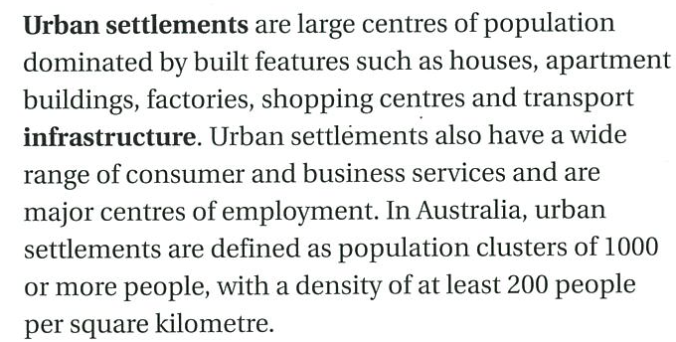


Slide 5
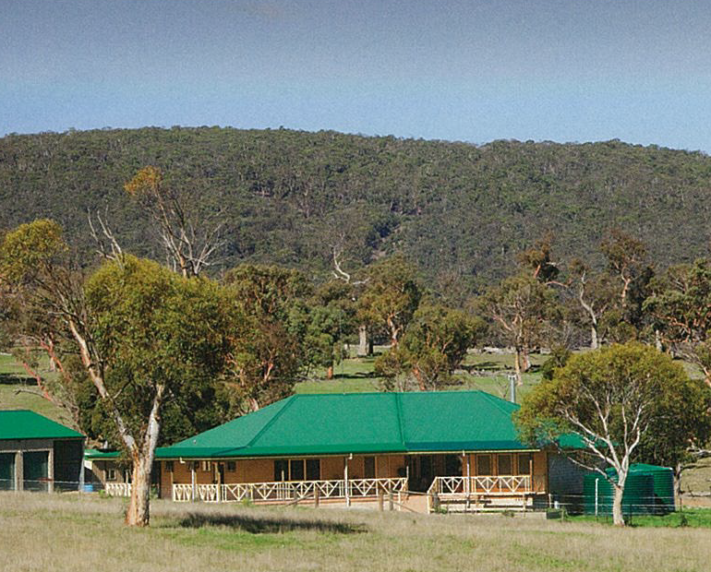
Rural areas are centres of agriculture and provide a small range of goods and services. There are two types: clustered and dispersed.

Slide 6
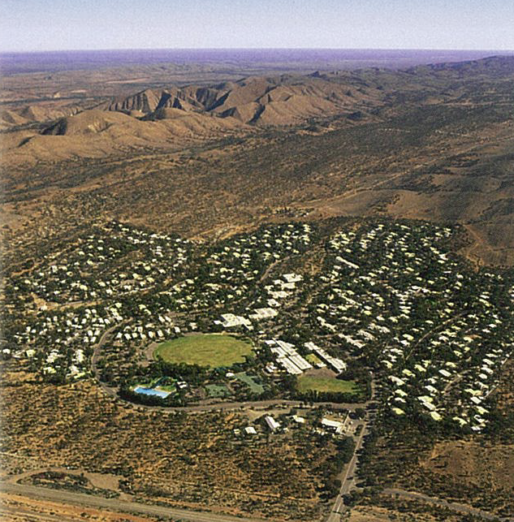
Remote areas are those places that are a long way away (isolated) from the main centres of population. E.G. Australia’s mining communities.

Slide 7

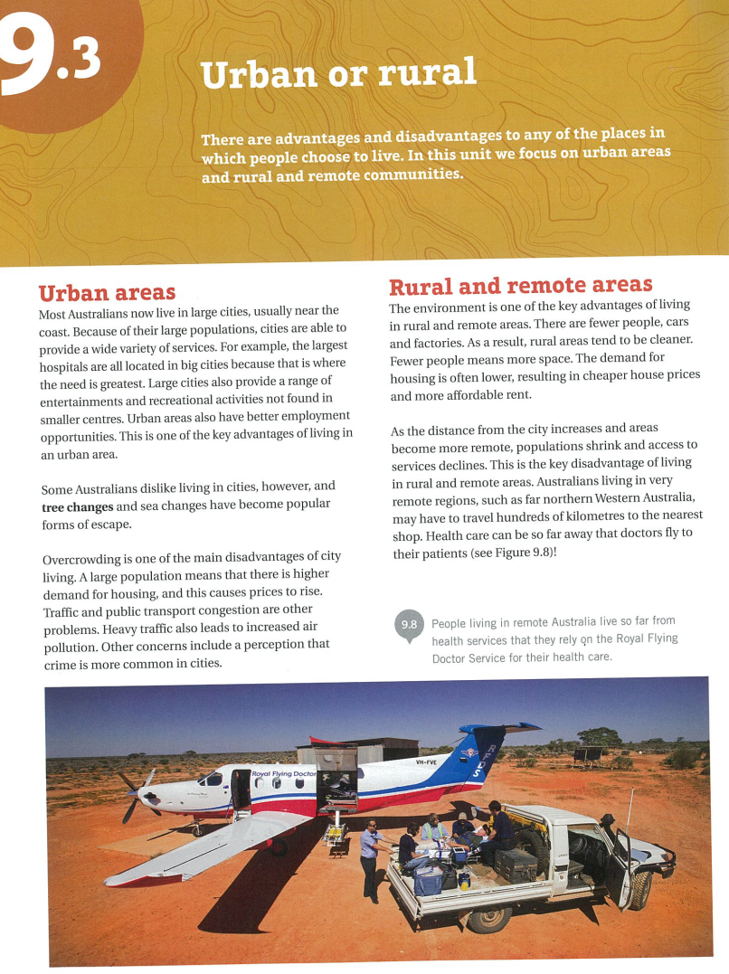

YOUR TASK

Slide 8



YOUR TASK
Urban
Draw a chart to show the advantages and disadvantages of living in each of the three areas:
Rural
 | Urban | Rural | Remote
Remote

Slide 9
YOUR TASK
Use reading strategies:
Underline new vocabulary
Highlight key words
Identify key dates and people – circle them

Slide 10
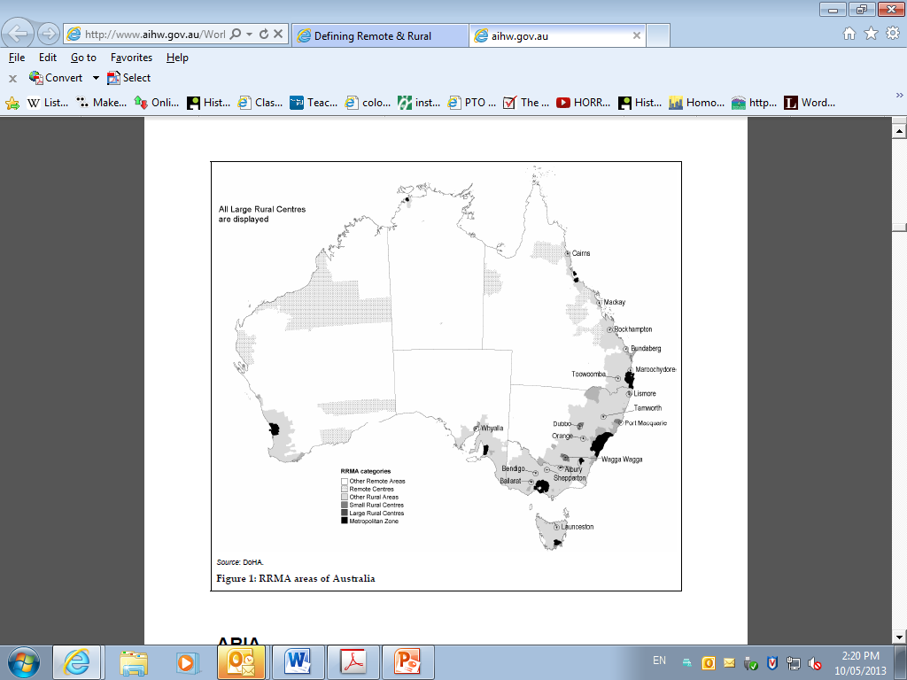

Slide 11
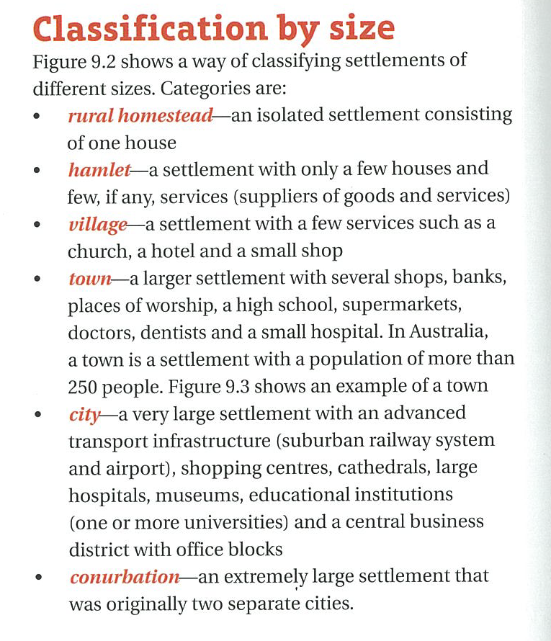
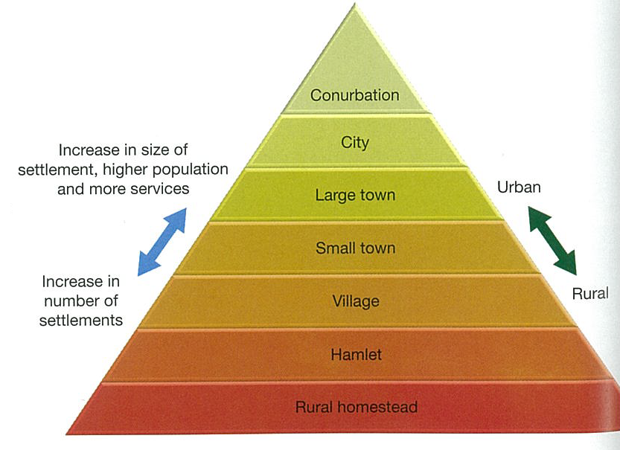

Slide 12
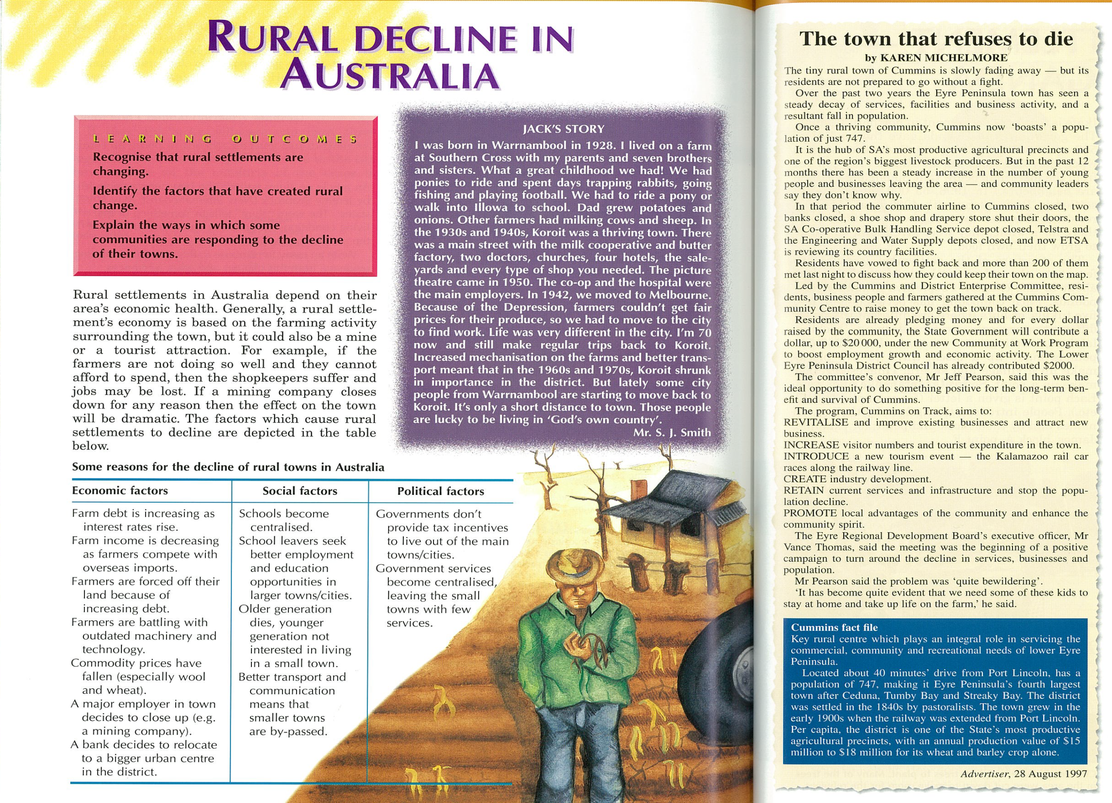


Slide 13
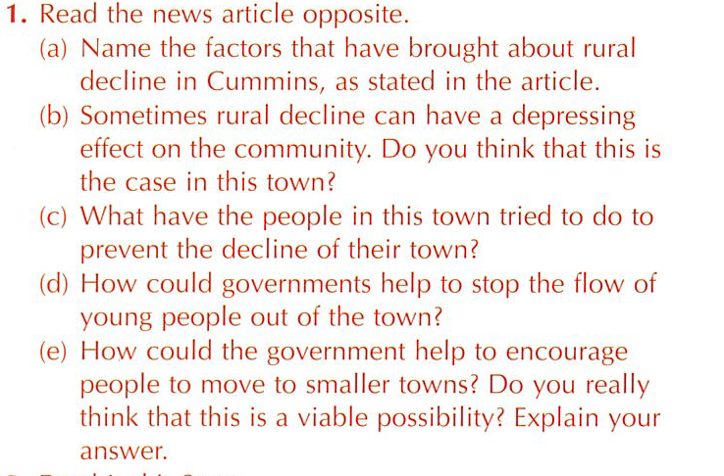


Write

Slide 14
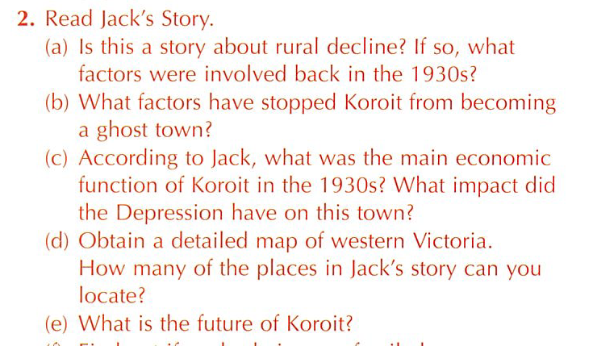
Write

